Slide 1
به نام انکه جان را حکمت اموخت

Slide 2
Intra-ovarian platelet- rich plasma administration in patients with poor ovarian response
Ovarian aging
Marzieh Farimani,

Slide 3
Life expectancy of human beings has greatly increased from 45 to 85 years over the past 150 years , but the age at natural menopause has remained around the age of 50 years
The genetic integrity of oocytes decreased with advancing age and almost half of women are infertile by the age of 40 years .
More women are choosing to delay childbearing to more advanced age worldwide, resulting in more frequent use of assisted reproductive technology .
Also, there is only an approximately 6.5% chance of achieving pregnancy with each mature oocyte thawed from the preservation of oocytes or ovarian tissue, which decreases with age .
Therefore, prevention of age-associated infertility becomes extremely important to the woman as well as to the family and society.

Slide 4
Excessive serum FSH also acts directly on hippocampal and cortical neurons to accelerate amyloid-β and tau deposition and impair cognition in female mice displaying features of Alzheimer’s disease [24]
Ovarian aging and disrupted endocrine function increases risk of reproductive aging-associated chronic diseases such as heart disease, incontinence, osteoporosis and mood.

Slide 5
Ovarian age
Ovarian age is classically considered the main cause of female reproductive infertility.
In women, the process proceeds as an ongoing decline in the primordial follicle stockpile and it is associated with reduced fertility in the mid-thirties, irregular menstruation from the mid-forties, cessation of fertility, and, eventually, menopause in the early fifties.
Reproductive aging is historically associated with changes in oocyte quantity and quality.

Slide 6
However, besides the oocyte, other cellular as well as environmental factors have been the focus of more recent investigations, suggesting that ovarian decay is a complex and multifaceted process. Among these factors, we will consider mitochondria and oxidative stress as related to nutrition, changes in extracellular matrix molecules, and the associated ovarian stromal compartment where immune cells of both the native and adaptive systems seem to play an important role.
Understanding such processes is crucial to design treatment strategies to slow down ovarian aging and consequently prolong reproductive lifespan and, more to this, alleviating side effects of menopause on the musculoskeletal, cardiovascular, and nervous systems

Slide 9
Aging
While the term “aging” implies a process typically associated with later life, the consequences of ovarian aging are evident by the time a woman reaches her forties, and sometimes earlier.
This is due to a gradual decline in the quantity and quality of oocytes which occurs over a woman’s reproductive lifespan.
Indeed, the reproductive potential of the ovary is established even before birth, as the proper formation and assembly of the ovarian germ cell population during fetal life determines the lifetime endowment of oocytes and follicles.
sophisticated molecular processes have been identified that regulate the timing of ovarian aging and these are critical to ensuring follicular maintenance.

Slide 10
Aging
Furthermore, deterioration of gamete quality occurs with age, increasing the risk of birth defects and miscarriage.
This means that many women now spend a larger portion of their lives in the postmenopausal period, increasing the incidence of comorbidities.
In women with primary ovarian insufficiency , this process is catastrophically accelerated, causing loss of fertility and early menopause .

Slide 11
Aging
The mechanisms thought to contribute to overall aging have been summarized under the term the “hallmarks of aging” and include such processes as
DNA damage,
mitochondrial dysfunction,
telomere attrition
genomic instability,
stem cell exhaustion, among others.
Similarly, in the ovary, molecular processes have been identified that regulate the timing of ovarian aging and these are critical to ensuring follicular maintenance.
Although the median age of menopause is 51 years of age, egg quality is well-known to become significantly compromised much earlier, late in the third decade of life.

Slide 12
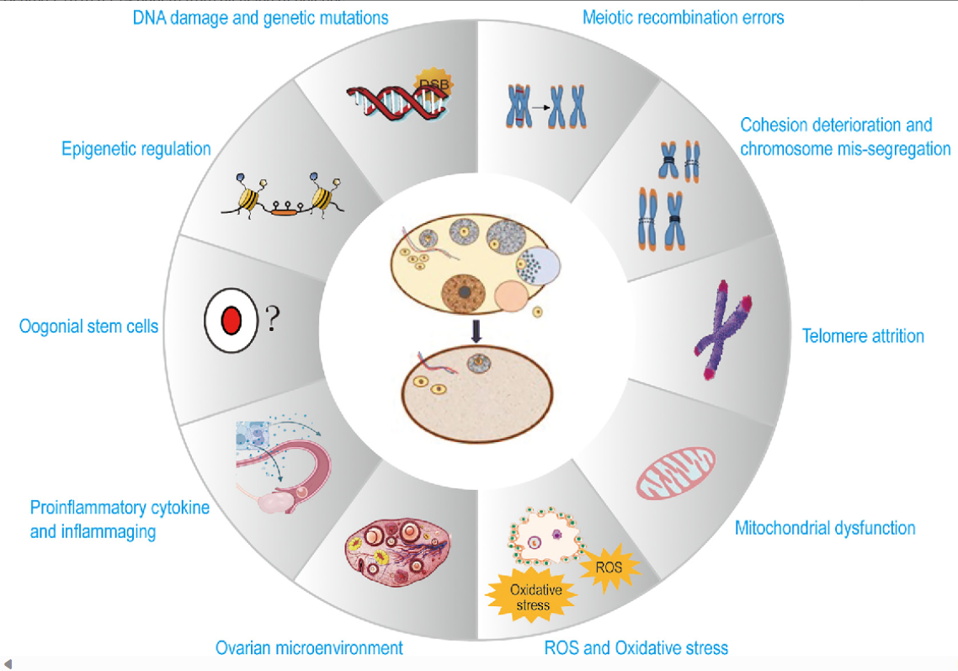
Current understanding of molecular mechanisms underlying ovarian aging. A multitude of physiological factors and molecular changes that can diminish the quantity and quality of ovarian reserve lead to ovarian aging. Most factors are explained further under subheadings in the text. DSBs, double-strand breaks; ROS, reactive oxygen species.

Slide 13
Signaling Pathways Regulating Primordial Follicle Activation
mechanisms that impact the rate of loss of primordial follicles
mechanisms of regulate DNA damage repair and chromosomal stability.
During folliculogenesis, primordial follicles develop to primary, preantral, antral and preovulatory stages, at which point they are able to release a mature oocyte for fertilization.
Cohorts of growing follicles are continuously recruited from the large pool of primordial follicles that reflects the ovarian reserve.
Most recruited follicles are destined to die via atresia, and this means that only about 450 follicles will mature and reach ovulation in the normal human reproductive lifespan (although the number of follicles lost over a lifespan is orders of magnitude higher than that)
[Wallace and Kelsey, 2010].

Slide 14
Signaling Pathways Regulating Primordial Follicle Activation
much attention has been paid to the identification of gene expression pathways which regulate rate of primordial follicle activation and recruitment, with an eye toward strategies to activate dormant primordial follicles and restore ovarian function
Central regulators of rate of primordial follicle activation include the PI3K/AKT/mechanistic target of rapamycin (mTOR) pathway, a prominent regulator of cell survival, growth, and migration.
A key enzyme in this pathway is phosphatase and tensin homolog deleted on chromosome ten (PTEN) [Reddy et al., 2008; Jagarlamudi et al., 2009]

Slide 15
Activation of AKT initiates localization of transcription factors which suppress follicle activation (e.g., FOXO3) [Kallen et al., 2018]. The main substrate of PTEN is the product of PI3K, phosphatidylinositol-3,4,5 triphosphate (PIP3); high levels of PIP3 recruit AKT to the cell membrane for activation [Maidarti et al., 2020].

Slide 16
Hipp0signaling
mTOR inhibition with small molecule inhibitors in mice has been shown to protect ovarian reserve, primordial follicles, anti-Müllerian hormone (AMH) levels, and fertility in cyclophosphamide-treated mouse model [Goldman et al., 2017; Guo and Yu, 2019].
Hippo signaling restrains follicle growth, while mechanical Hippo disruption promotes follicle growth [Grosbois and Demeestere, 2018].
Thus, mechanical ovarian fragmentation has been used as a strategy to activate resting follicles in vitro
Twenty-seven patients with POI underwent ovarian tissue harvesting and fragmentation of harvested tissues, followed by in vitro AKT treatment and auto transplantation of the fragmented tissue. While follicle growth was subsequently observed in 8 patients and mature oocytes were retrieved from 5 patients, only one woman achieved a live birth; this success rate is similar to the spontaneous pregnancy rate in women with POI [Kawamura et al., 2013].

Slide 17
AMH
Finally, AMH represents a critical “gatekeeper” hormone which regulates follicular quantity by inhibiting recruitment and growth.
AMH is involved in two key steps of follicle development:
Inhibition of primordial follicle recruitment, and suppression of small follicle growth by reducing the follicle’s sensitivity to follicle-stimulating hormone (FSH) [Durlinger et al., 1999, 2001, 2002].
The use of exogenous AMH represents an innovative potential preventative strategy and therapeutic option for gonadotoxic-induced follicle loss.
In a recent study, co-treatment with exogenous delivery of AMH in chemotherapy-exposed mice resulted in inhibition of PFA, though the protective effect varied between agents used [Kano et al., 2017].

Slide 18
Ovarian Aging at the Level of Oocytes: Damage DNA Repair(DDR) pathways
During female mammalian meiosis, which begins during fetal life, gametes undergo a single round of DNA replication followed by two rounds of chromosome segregation to produce haploid oocytes. This process arrests at meiotic prophase I during gestation until oocytes recommence meiosis decades later or undergo atresia [Gebel et al., 2020].
Indeed, prophase-arrested oocytes are among the longest-living cells in the human body.
Before entering prophase arrest, oocytes are subject to a series of programmed DNA double-strand breaks
Repair of these DNA double-strand breaks through homologous recombination generates inter-homolog crossovers and maintains genomic integrity [Winship et al., 2018; Stringer et al., 2020].
RAD51 recombinase and BRCA1 implicated in cell cycle and transcriptional regulation and DNA repair
If repairs cannot be made, oocytes are targeted for apoptosis and ultimately follicular atresia [Stringer et al., 2020].

Slide 19
Ovarian Aging at the Level of Oocytes: Damage DNA Repair(DDR) pathways
Interestingly, while apoptosis is the preferential mechanism for elimination of prophase-arrested oocytes after DNA damage
These findings implicate DNA repair as a critical quality control mechanism
The implications for future therapeutic strategies designed to rescue aging oocytes from apoptosis are consequential: given that depletion of oocytes in the aging ovary results in infertility and menopause, therapeutic strategies to block oocyte loss can be expected to be successful only if rescued oocytes are viable and healthy.
mouse oocytes engineered to overexpress BRCA1 have higher survival rates and fewer DSBs after exposure to genotoxins [Titus et al., 2013a].

Slide 20
Indeed, successful reproduction relies on the well-orchestrated development of oocytes through meiosis.
During meiotic prophase, homologous chromosomes must pair, synapse, and undergo meiotic recombination. Spatial control of chromosomes is achieved in part via meiotic cohesion complexes[Gorbsky, 2015].
Cohesion proteins are important, leading up to separation in anaphase because they act to establish the metaphase plate [Mihajlović and FitzHarris, 2018].
Further supporting a role for cohesion dysfunction in oocyte aging, multiple cohesion variants have been associated with familial POI [Beverley et al., 2021].
Spindle Instability and Cohesin Dysfunction

Slide 21
Telomere Shortening
Telomeres, or repeats of noncoding DNA located at the ends of chromosomes, function as physical “caps” to protect the genome from shortening during DNA replication .
In somatic cells, telomere lengths shorten through cell division until they are exhausted, triggering cellular senescence [Rocca et al., 2019].
In support of a link between telomeres and female reproductive aging, studies have shown reduced activity of telomerase in granulosa cells from women with occult ovarian insufficiency, as well as reduced leukocyte granulosa cell telomere length [Butts et al., 2009; Xu et al., 2017].
Indeed, cumulus cell telomeres are significantly longer than leukocyte telomeres [Lara-Molina et al., 2020] which may be a result of a unique “coping strategy” in follicles to protect against telomere shortening
embryo polar body and blastomere biopsies have shown no correlation between TL and female age, or between embryo aneuploid status and age [Turner et al., 2019].

Slide 22
Mitochondrial Dysfunction and Oxidative Stress
Mitochondria are double-membrane-bound intracellular organelles essential for anaerobic metabolism and energy production.
Mitochondria produce ATP during energy metabolism and during this process constantly generate reactive oxygen species (ROS); these are eliminated by antioxidant enzymes in the mitochondria.
While most cellular DNA is located in the nucleus, DNA is also found in mitochondria
Human mtDNA is inherited solely from the mother, except in rare cases of inheritance of both maternal and paternal mtDNA [Parr and Martin, 2012].
The “Free Radical Theory of Aging” postulates that oxidative stress contributes to cellular aging due to the accumulation of reactive oxidative species [Yang et al., 2021].
Mitochondrial dysfunction can also result from mitochondrial mutations or from aberrant DNA repair [Chiang et al., 2020]

Slide 23
Mitochondrial Dysfunction and Oxidative Stress
Melatonin, a free radical scavenger, is present in follicular fluid and oocytes [Nakamura et al., 2003; Cruz et al., 2014].
Melatonin treatment in vitro increases expression of hyaluronan synthase-2 and progesterone receptor genes, which are critical for cumulus cell expansion, and improves fertilization rates in mouse cumulus cell-oocyte complexes treated with melatonin [Ezzati et al., 2018].
A randomized trial of melatonin supplementation in 40 women with unexplained infertility concluded that daily melatonin supplementation (3 mg or 6 mg) improved oxidative balance and oocyte quality [Espino et al., 2019].
Follicular fluid melatonin levels have been shown to correlate with progesterone levels in women undergoing in vitro fertilization [Nakamura et al., 2003];

Slide 24
Sirtuins and Ovarian Aging
Sirtuins are a family of nicotinamide adenine dinucleotide-dependent deacetylasesand are important modulators of cellular metabolic processes.
Sirtuins can be present in the nucleus , in mitochondria , or in the cytoplasm , and can relocate during cell differentiation.
Sirtuins are implicated in diseases of aging including cancers, metabolic disorders, and neurodegenerative diseases, and have emerged as candidate predictive markers and therapeutic targets for ovarian aging [Zhang et al., 2016].

Slide 25
Sirtuins and Ovarian Aging
SIRT1, one of the most well-studied enzymes of the sirtuin family, is involved in the regulation of DNA repair and apoptosis, mitochondrial production, and the cell stress response [Chandrasekaran et al., 2017].
Caloric restriction, which preserves ovarian follicle numbers in rodent models, results in elevated ovarian SIRT1 and SIRT6 ovarian protein levels [Luo et al., 2012; Long et al., 2019]
Treatment of mice with a SIRT1 activator also results in a significantly increased number of primordial follicles and suppresses mTOR signaling; mTOR inhibition has been shown to prolong reproductive longevity in a mouse model of physiologic ovarian aging [Goldman et al., 2017].

Slide 26
Inflammation
Inflammation, another hallmark of aging, has been linked to female reproductive aging.
Aged mouse ovaries demonstrated an enhanced inflammatory environment, with increased expression of TNF-α, IL6,IL1a, IL1b, and IL10 mRNA [Lliberos et al., 2021] and presence of multinucleated giant cells [Briley et al., 2016].
Corresponding to these results, female TNF-α knockout mice (TNF-α−/−) have increased frequency of estrous cycles, increased granulosa cell proliferation and reduced oocyte apoptosis, and produce 21% more pups than control mice during a 12-month breeding period [Cui et al., 2011].

Slide 27
Inflammation
In humans, a prospective study found that early menopause risk was lower in women with moderate tumor necrosis factor receptor 2 (TNFR2, an antagonist of TNF-α activity) levels compared to women with low TNFR2 levels [Bertone-Johnson et al., 2019].
Women with POI also exhibit an increased serum inflammatory environment, as exhibited by a lower neutrophil-to-lymphocyte ratio(NLR) than normal fertile women; in multivariate logistic regression analysis, a NLR ≤1.5 was an independent risk factor for POI [Ilhan et al., 2016].
Inflammation also plays a fundamental role in the development of tissue fibrosis, and fibrotic changes have been observed in the aging mouse ovary [Briley et al., 2016]. However, whether suppression of inflammatory processes can delay human ovarian aging remains to be determined.

Slide 28
Noncoding RNAs
In the last half-century, the central dogma of molecular biology – that genes are transcribed into mRNA, and mRNA is translated into protein – has been revised.
It’s now known that mRNA makes up only about 1.5% of the genome.
It has become abundantly clear that noncoding RNAs (ncRNAs), RNA transcripts with no protein product, are integral to the function of cells, particularly in the control of gene activity and translational regulation.
ncRNAs have multiple and diverse cellular functions, with one critical function being the silencing of target mRNA translation [Brosnan and Voinnet, 2009; Kallen et al., 2013; Cech and Steitz, 2014; Grimson, 2015]
Age-related changes in ncRNA expression, suggesting that reproductive aging is associated with significant alterations in ncRNA pathways [Barragán et al., 2017; Schneider et al., 2017].

Slide 29
Noncoding RNAs
The lncRNA H19 represents one candidate regulator of ovarian aging [Kallen et al., 2013]. H19 was discovered as the first lncRNA over 3 decades ago and is a highly conserved imprinted gene, suggesting a physiologic pressure to maintain function
Antagonist and agonists which up- or downregulate ncRNAs are already in use in other fields; as such, harnessing this technology to target candidate ncRNAs such as H19 may be key to the development of therapeutic interventions aimed at slowing ovarian aging.

Slide 30
Major Achievements and Areas of Debate
Currently, the most successful examples of intervening in cases when patients are at risk for early ovarian failure involves fertility preservation strategies such as the collection of oocytes, embryos, or ovarian cortical tissue.
Cryopreservation of oocytes and/or embryos has become an established method of fertility preservation in women at risk for accelerated ovarian aging such as those receiving gonadotoxic therapy for cancer treatment.

Slide 31
Novel Experimental Approaches to Delay or Treat Ovarian Aging
At present, there are no effective treatment modalities for women with POI who wish to have children with their own eggs.
It has been hypothesized that the administration of stem cells (e.g., via bone marrow transplant) can replenish intraovarian factors necessary for follicular growth [Sheikhansari et al., 2018; Yoon, 2019].
Another recent study of endometrial mesenchymal stem cells (MSC) injected into mice with chemotherapy-induced POI reported higher serum AMH levels, and ovulation rates, more developing follicles, and higher live birth rates [Liu et al., 2021].

Slide 32
Novel Experimental Approaches to Delay or Treat Ovarian Aging
PRP is a blood-derived product which is growth factor and chemokine rich, including factors such as platelet derived growth factor (PDGF), epidermal growth factor (EGF), insulin-like growth factor (IGF), transforming growth factor beta-1 (TGFβ-1), vascular endothelial growth factor (VEGF), hepatocyte growth factor (HGF), and basic fibroblast growth factor (bFGF) [Bos-Mikich et al., 2018; Scott Sills and Wood, 2019].
Consequently, intraovarian injection of PRP has been proposed as a strategy to activate dormant ovarian follicles before in vitro fertilization cycles in patients with diminished ovarian reserve or POI.
While studies have reported increased angiogenesis and antral follicle growth after culture with PRP

Slide 33
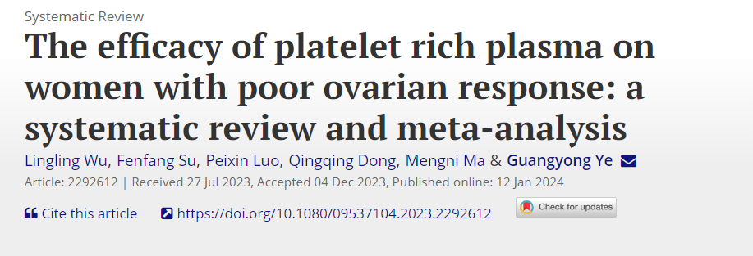
A total of 10 trials were enrolled in the present meta-analysis. Following PRP treatment, live birth rate was found to be 16.6% (95% CI 8.8%-26.1%), while clinical pregnancy rate was observed to be 25.4% (95% CI 13.1%-39.9%). PRP pretreatment resulted in a higher number of MII oocytes (MD 1.073, 95% CI 0.720 to 1.427), a higher number of embryos (MD 0.946, 95% CI 0.569 to 1.323), a higher antral follicle count (MD 1.117; 95% CI 0.689 to 1.544), and the change of hormone levels.

Slide 35
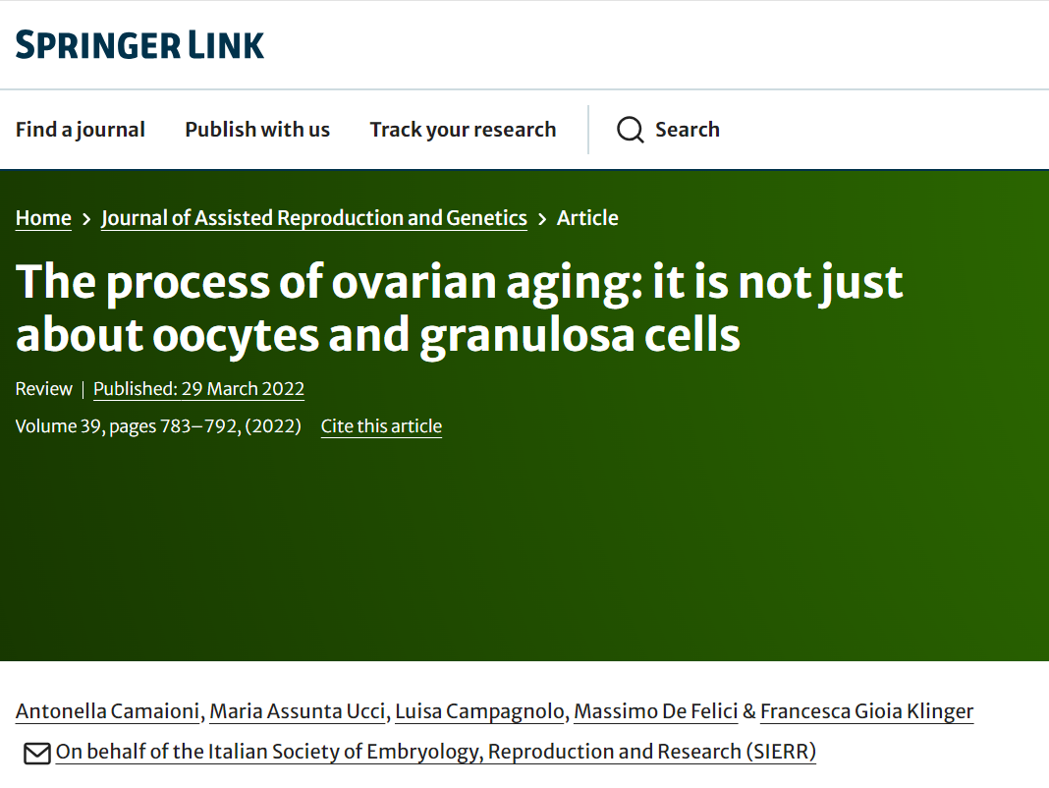

Slide 36
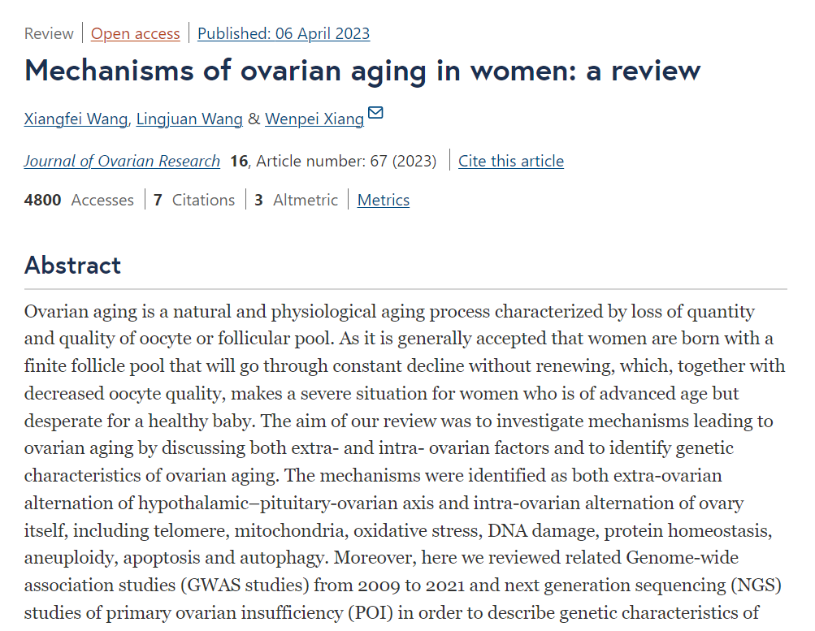

Slide 37
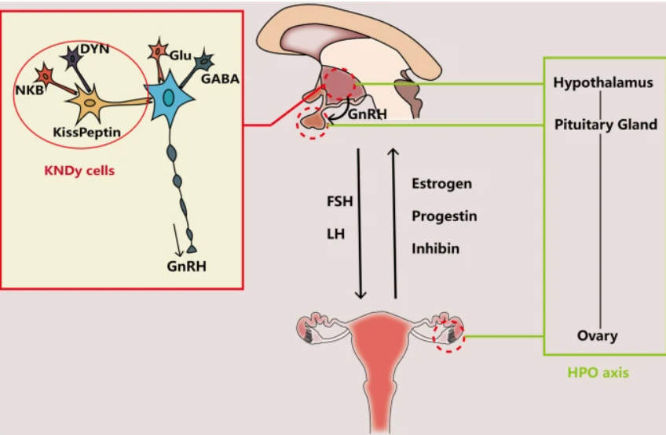
The interaction between brain and ovary through HPO axis by hormone release. Main neurotransmitter secretion in CNS that might affect the release of GnRH in hypothalamus include Glu, GABA and transmitters secreted by KNDy cells, including NKB, Kisspeptin and DYN. Brain interacts with ovary through hormones secreted from pituitary gland (FSH and LH) and from ovary (Estrogen, Progestin and inhibin). The relationship between ovary and brain can be described as HPO axis

Slide 38
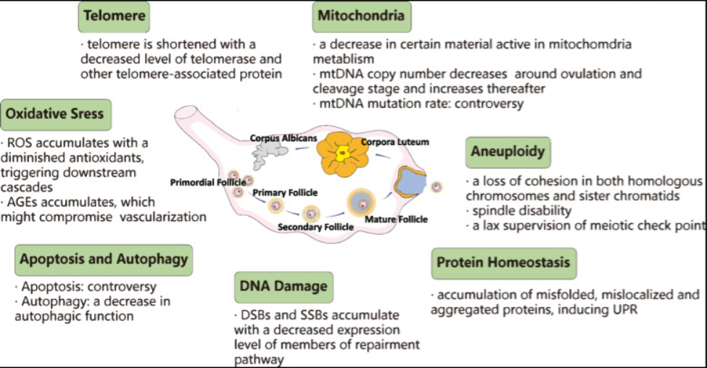
Overview of alternation in ovary with advanced age that contributes to ovarian aging

Slide 41
probability of a blastocyst being euploid blastocyst euploidy as a function of female age

Slide 43
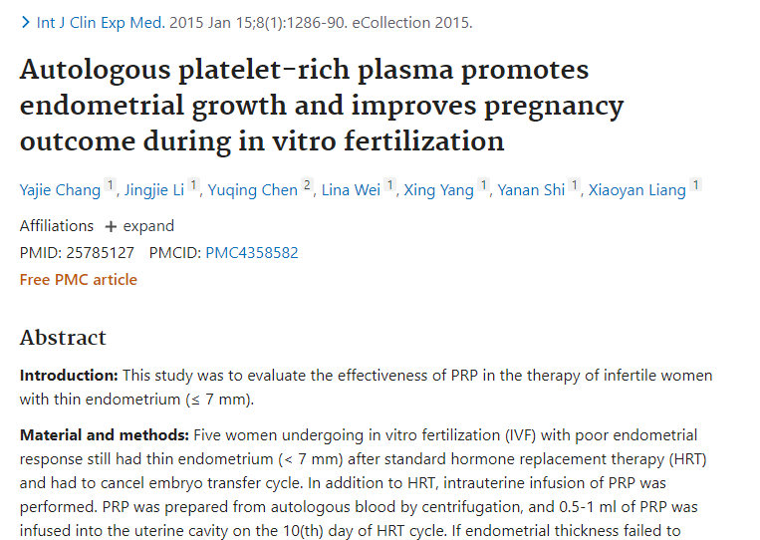

Slide 44
In September 2016 we reported intrauterine PRP injection in patients with recurrent implantation failure (RIF) which led to noticeable findings .

Slide 45
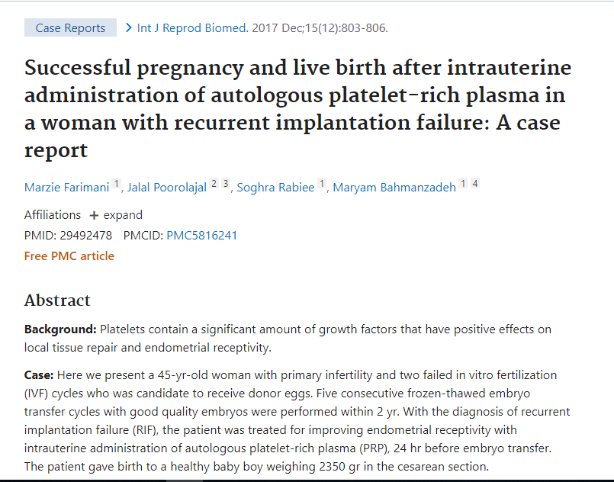

Slide 46
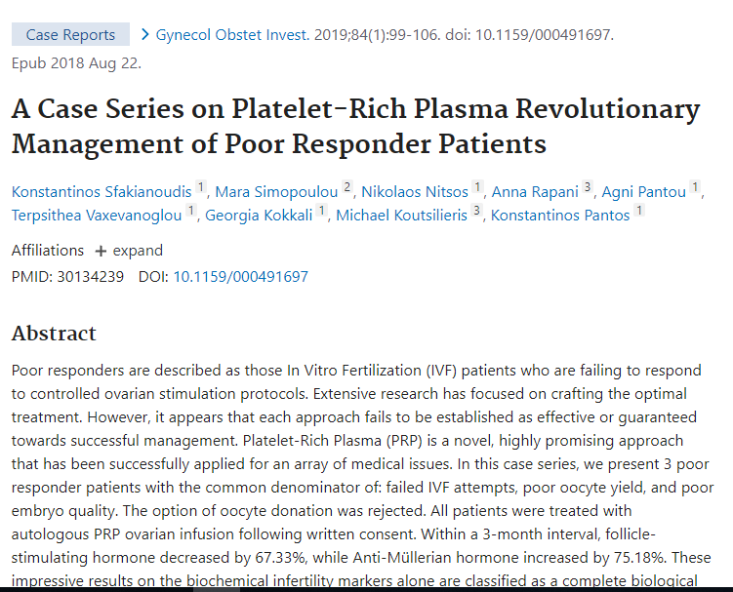

Slide 47
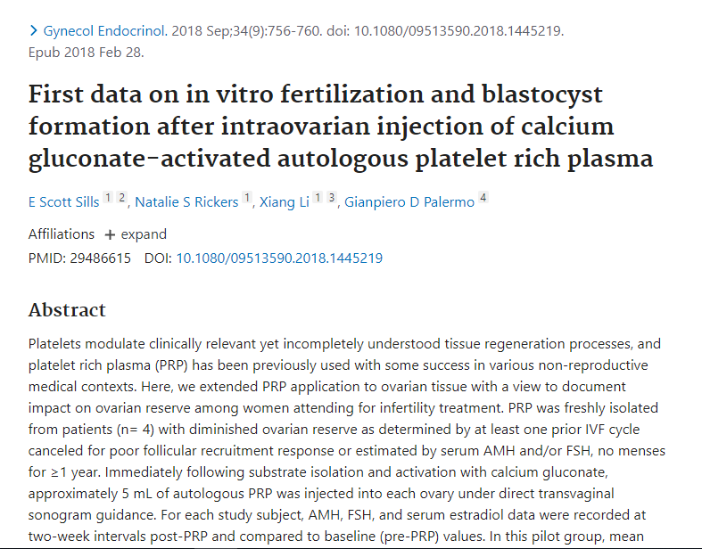

Slide 48
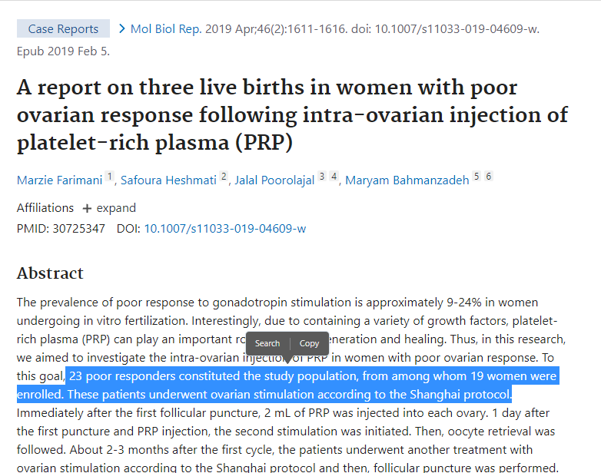

Slide 49
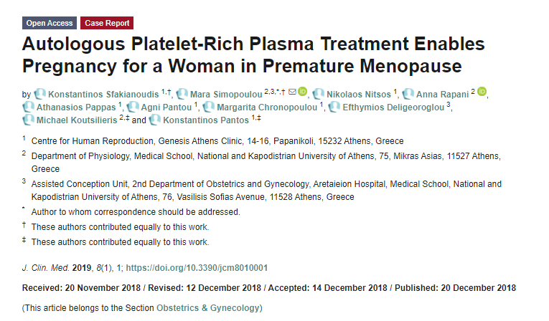

Slide 50
A report on 23 women with primary ovarian insufficiency has shown that PRP could be a proper treatment option for these patient A report on 23 women with primary ovarian insufficiency has shown that PRP could be a proper treatment option for these patients s

Slide 52
Result
From 383 cases, a total number of 96 women were enrolled in this study. According to the POSEIDON criteria,
group 4 (Age ≥ 35 years, AMH < 1.2 ng/mL) with the ratio of 56/96 (58.3%) had the highest prevalence among others.
As the analyses showed, changes in the laboratory variables (LH, FSH, AMH, and estradiol) were not significant in almost all the groups following the intervention.
Regarding the total oocytes number, PRP administration caused a significant increase in the total number in all the groups (all P < 0.05).
Also, the number of MII oocytes was significantly increased following the treatment in all groups except for group 2 (Age ≥ 35 years, AMH ≥ 1.2 ng/mL; all P < 0.05).

Slide 53
Method & Material

Slide 56
Discussion
The current study investigated the possible potentials of intra-ovarian PRP administration on the POR patients.
According to the results and following single session of the intervention, total oocytes count showed a statistically significant increase in all POSEIDON groups with more notable changes in group 4’ For the MI, MII, and GV oocytes
only MII ones experienced a significant increase in their count following PRP administration (but not in the group 2; Age ≥ 35 years, AMH ≥ 1.2

Slide 57
Result
Interestingly, this study showed that 9.75% of women with no ART got pregnant following a single session of PRP injection However, it was less than 14.75% for those cases undergone ART.
On the other hand, except for AMH in group 2 POSEIDON (17 patients), none of the other laboratory variables experienced a significant change in any of the POSEIDON groups.
This result showed that the changes observed in the outcomes of patients are more likely achieved through a non-hormonal pathway(s)..

Slide 58
Conclusion
An intra-ovarian injection of PRP in women diagnosed with POR showed results in favor of improved ovarian function including total oocyte number and especially MII oocytes.
On the other hand, AMH (other than POSEIDON group 2), FSH, LH, and estradiol did not significantly change.
This might be a clue to how PRP therapy in these patients did not exploited the hormonal pathways and there might be other mechanisms involved such as angiogenesis.

Slide 59
Thanks for your attention

